Slide 1


CASE D:
OUTSOURCING, NEAR-SOURCING, AND SUPPLY CHAIN FLEXIBILITY IN THE APPAREL INDUSTRY
8TH DEC 2022
IS610 BUSINESS DATA ANALYTICS DR. MING CHEN
Team β
Akshith Moyya, Ojal Gangwal, Tirth Modi, Varalaxmi Gangane

Slide 2

INTRODUCTION
Veizenburg was the one-stop destination for the people of Vienna when it came to purchasing shirts. Timm Veizenburg, who is passionate about resurrecting the family business, launched his online storefront in 2011. The company didn't use traditional media for advertising; instead, it displayed banner ads, bid on search terms, and appeared at gatherings.

Slide 3


PROBLEM STATEMENT
In its second year the LEC project, it is clear from the sales report that many of the LEC shirts remained unsold.
Various tactics were implemented to clear this inventory like selected customers were offered a “buy two, get one free” promotion.
Widespread markdowns as practiced in the retail industry were not considered, as they could tarnish the brand’s prestige and reputation for high quality.
With the limited promotions offered, the average net price per LEC shirt was $135.

Slide 4

PROBLEM STATEMENT
The business is not booming as much with the Ukrainian partners, and they would be able to turn around up to 1,000 shirts within a week, delivery included, at the same $65.
The company adopts the outsourcing strategy and only works with the manufacturer in Ukraine. The company places a single order well before the season starts. Due to its long lead time, there is no chance to place a second order if the demand turns out to be high.
The company adopts a more flexible strategy and uses a combination of outsourcing and near- sourcing. The company places its first order before the season starts from the manufacturer in Ukraine and then places a second order from the local manufacturer if demand turns out to be high.
We have to analyze how many shirts should be ordered for the upcoming season.

Slide 5
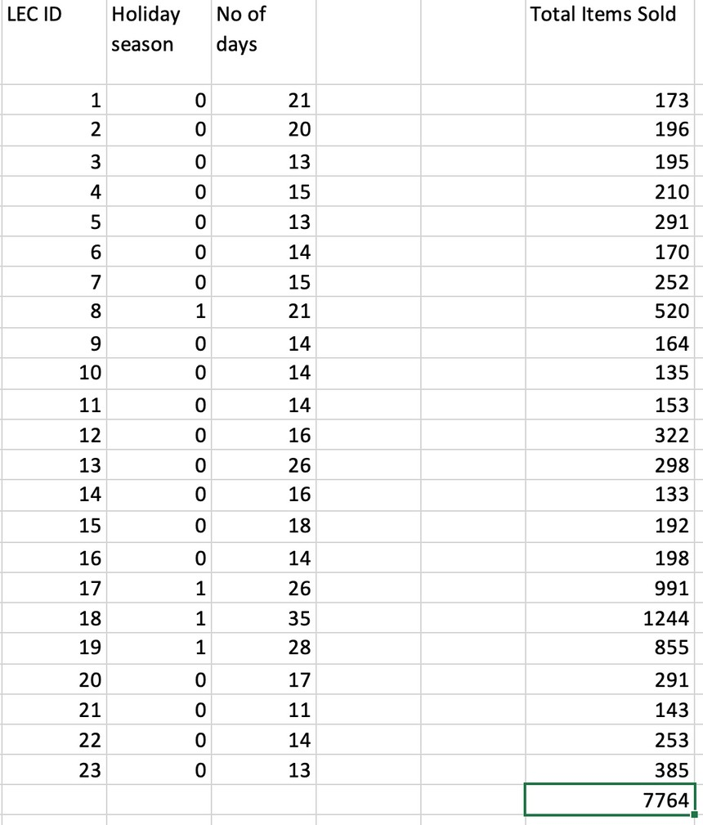
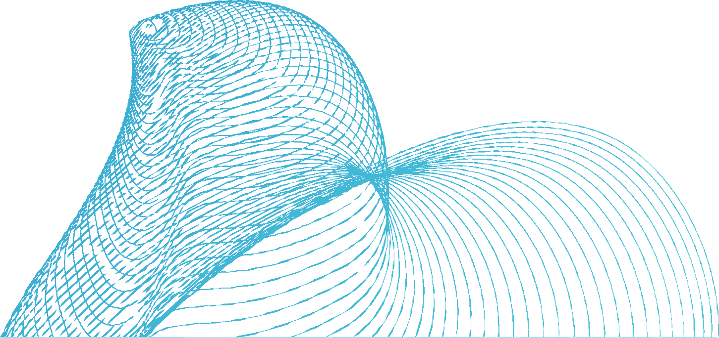
ANALYSIS
We could categorize 2 independent variables, namely, the Holiday Season and the number of days in each season where the holiday season can take 0 and 1 where 0 constitutes a Non-holiday season and 1 otherwise; the Number of days variable holds a numeric value.
The obtained equation from the Linear regression model is as follows:
Y=B0+B1*X1+B2*X2+Error term. Where:
B0 = Intercept = -51.7862
B1 = Slope (Holiday season) = 480.147 and X1 = 0 (Non Holiday season)
B2 = Slope (No of days in a season) = 17.241 and X2 = 21 (Non Holiday season)
Standard Error = 115.859
Error term = NORM.INV(Rand(), Mean=0,Standard_Error),0)

Slide 6
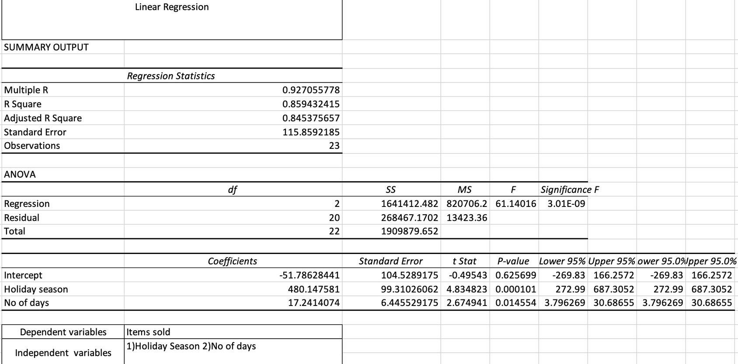
ANALYSIS

Slide 7

ANALYSIS
SCENARIO 1:
For outsourcing only, orders need to be placed upfront before the season starts and cannot accommodate any unprecedented demand.
It is observed that in a few cases, the demand is not fulfilled as the orders have to be placed upfront. However, the situation could have been better if unprecedented demand was addressed after prior order.

Slide 8
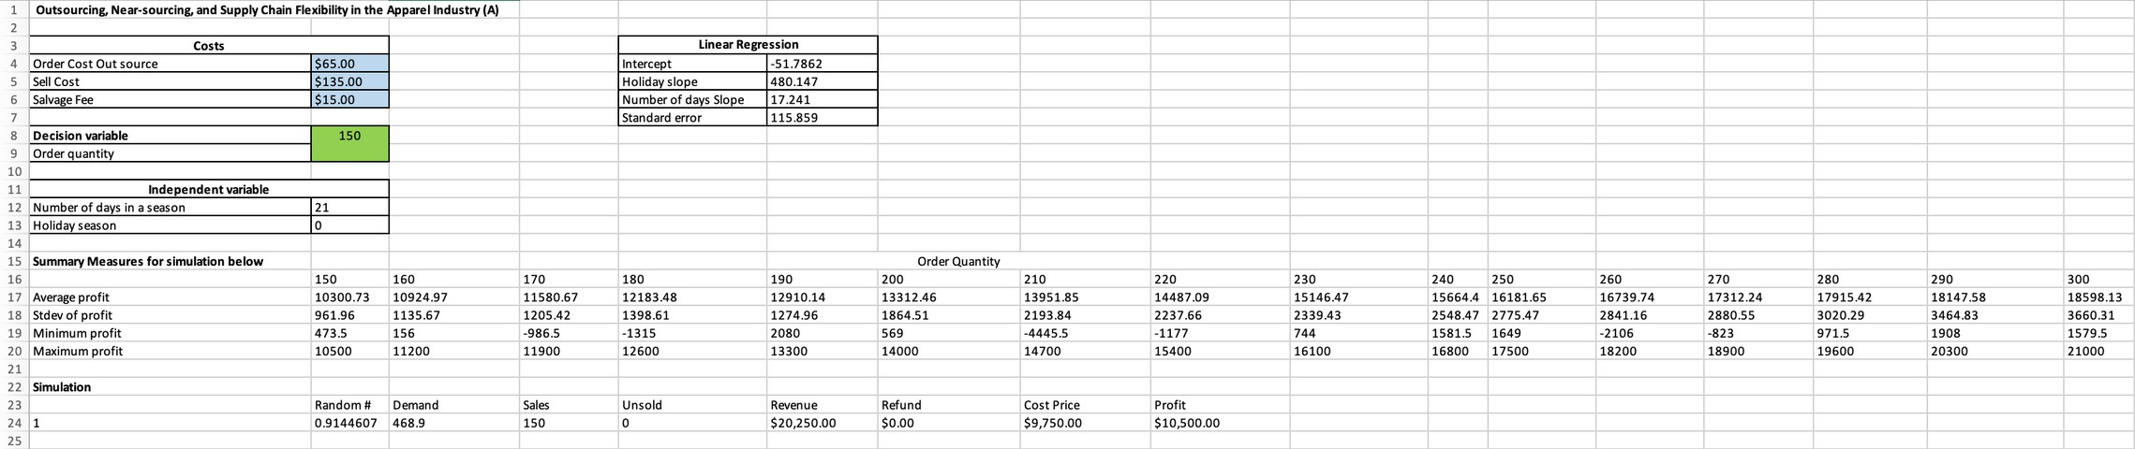
ANALYSIS

Slide 9

ANALYSIS
SCENARIO 2:
Along with outsourcing, insourcing is also considered in this scenario, where orders exceeding order quantity were bought from the insourcing facility, with limitations.
Insourcing facility could only accommodate 12 shirts a day which is 252 shirts for a season.
The demand is fulfilled better than scenario 1 as insourcing is considered but, it still isn’t accommodated in some scenarios due to the limitations stated above.

Slide 10
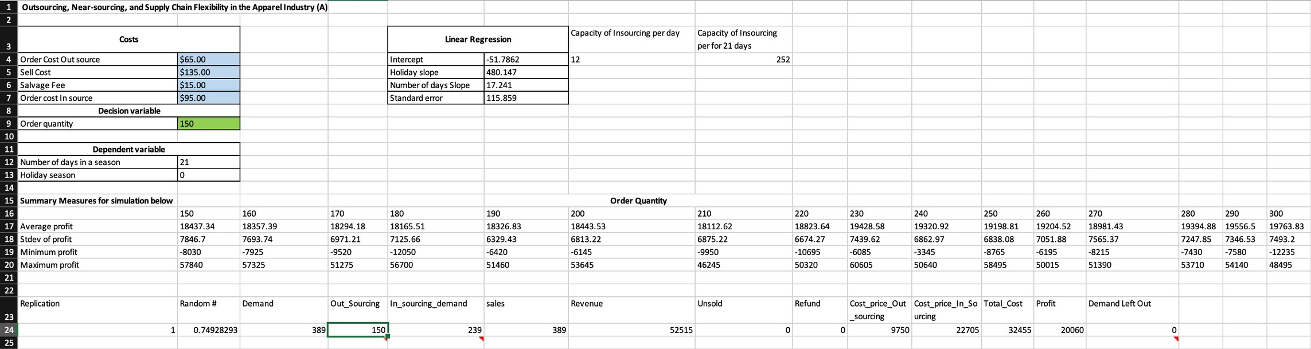
ANALYSIS

Slide 11
CONCLUSION
Based on our analysis of Scenario 1, we conclude that the profit is determined by holiday season and by the number of days in a season. When compared to non-holiday seasons, sales are higher during the holiday season. The average profit increased in lockstep with the order quantity. When the order quantity is 300, the profit is at its peak. However, as we increased the order quantity above 300, we noticed that the number of unsold products increased, resulting in a loss. As a result, if the order quantity exceeds 300, there will be a loss.
Based on our analysis for Scenario 2, we conclude that profit is dependent on the order placed from both insourcing and outsourcing. If demand is high, orders must be placed from local vendors, and the maximum order quantity that can be ordered is 252 per season due to capacity constraints.

Slide 12

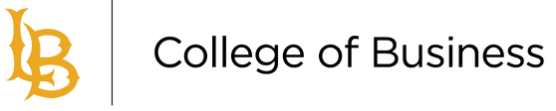
THANK YOU!

